Slide 1

Assembly Music years 3 and 4

Slide 2
Autumn term

Slide 3
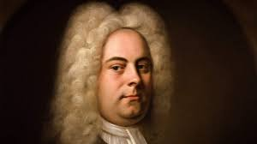
Handel was a German composer but lived most of his life in London.
He lived in the late Baroque period.
Handel wrote many operas and oratorios and by them became very famous.
He took many trips, including to Italy where he learned a lot about composition.
Handel wrote over 42 operas. Later he wrote oratorios. His most famous oratorio is the Messiah. He wrote anthems, chamber music and orchestral music including the Water Music and Music for the Royal Fireworks.
https://youtu.be/DJ-3cakmglM
George Frideric Handel
The Cuckoo and the Nightingale
1685 - 1759

Slide 4
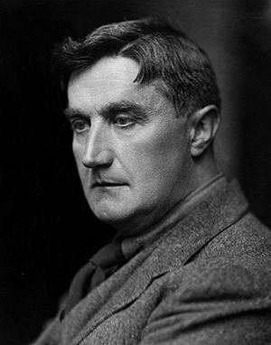
https://youtu.be/Ak85S5KZoKE
Vaughan Williams was an English composer.
His works include operas, ballets, chamber music, secular and religious vocal pieces and orchestral compositions including nine symphonies, written over sixty years.
Strongly influenced by Tudor music and English folk-song, his output marked a decisive break in British music from its German-dominated style of the 19th century.
Vaughan Williams is among the best-known British symphonists, noted for his very wide range of moods, from stormy and impassioned to tranquil, from mysterious to exuberant. Among the most familiar of his other concert works are Fantasia on a Theme by Thomas Tallis (1910) and The Lark Ascending (1914).
Vaughan Williams
12 October 1872– 26 August 1958
Fantasia on Greensleeves.

Slide 5
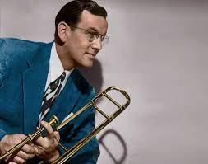
Glen Miller
1904-1944 https://youtu.be/_kjB88Ls4g4
Alton Glenn Miller (March 1, 1904 – disappeared December 15, 1944)
He was an American big-band trombonist, arranger, composer, and bandleader in the swing era.
He was the best-selling recording artist from 1939 to 1942, leading one of the best-known big bands.
Miller's recordings include "In the Mood", "Moonlight Serenade", "Pennsylvania 6-5000", "Chattanooga Choo Choo", "A String of Pearls", "At Last", "(I've Got a Gal In) Kalamazoo", "American Patrol", "Tuxedo Junction", "Elmer's Tune", "Little Brown Jug" and "Anvil Chorus".
In just four years Glenn Miller scored 16 number-one records and 69 top ten hits—more than Elvis Presley (38 top 10s) and the Beatles (33 top 10s) did in their careers.
In 1942, Miller volunteered to join the U.S. military to entertain troops during World War II, ending up with the U.S. Army Air Forces. On December 15, 1944, while flying to Paris, Miller's aircraft disappeared in bad weather over the English Channel. He was posthumously awarded the Bronze Star Medal.

Slide 6

https://youtu.be/oLVLNoxF4L0
https://youtu.be/eVY_5CoxFOg
Nigel Kennedy is an English violinist and violist. His early career was primarily spent performing classical music, and he has since expanded into jazz, klezmer, and other music genres.
Klezmer is an instrumental musical tradition of the Ashkenazi Jews of Central and Eastern Europe. The essential elements of the tradition include dance tunes, ritual melodies, and virtuosic improvisations played for listening; these would have been played at weddings and other social functions.
Nigel Kennedy Band plays arrangements by Bach in Jazzed up style
born 28 December 1956

Slide 7
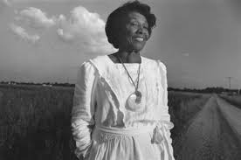
Lots of Undine’s work was inspired by Black Spirituals and folk music.
https://youtu.be/9ZuPwAiET6E
Undine Eliza Anna Smith Moore
Watch and Pray
(25 August 1904 – 6 February 1989)

Slide 8
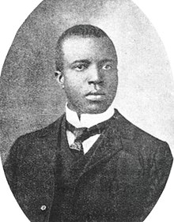
https://youtu.be/PbA8CAacNZ4
Scott Joplin was an African-American composer and pianist. Joplin is also known as the "King of Ragtime" because of the fame achieved for his ragtime compositions, music that was born out of the African-American community.
"The Entertainer" is a 1902 classic piano rag written by Scott Joplin.
It was sold first as sheet music, and in the 1910s as piano rolls that would play on player pianos. The first recording was by blues and ragtime musicians the Blue Boys in 1928, played on mandolin and guitar.
Scott Joplin
Entertainer
1868 – April 1, 1917

Slide 9
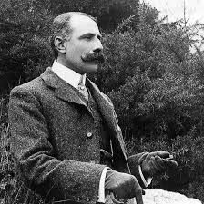
Elgar came from a humble family background originally.
He was the most famous English composer of his time. He composed in the late romantic era.
Elgar was born in Broadheath, Worcestershire. His father owned a music shop. Apart from having violin lessons Elgar taught himself about music. He studied the printed music in his father’s shop and often travelled with him when he went on his rounds to tune pianos. He heard a lot of cathedral music and often practised the organ. He took over his father’s job as church organist and soon became conductor of local orchestras and bands.
https://youtu.be/hhq3YGW62xY
Sir Edward William Elgar
Nimrod
( 2 June 1857 – 23 February 1934)

Slide 10
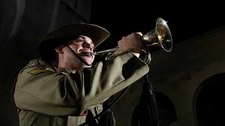
The "First Post" call signals the start of the duty officer's inspection of a British Army camp's sentry posts, sounding a call at each one. The "Last Post" call originally signalled merely that the final sentry post had been inspected, and the camp was secure for the night. In addition, the "Last Post" call had another function at the close of a day of battle. It signalled to those who were still out and wounded or separated that the fighting was done, and to follow the sound of the call to find safety and rest.
The Last Post
https://youtu.be/99tCg596QSc

Slide 11
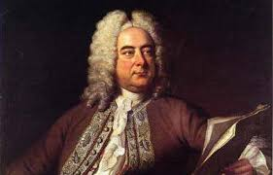
Handel was a German composer but lived most of his life in London in the late Baroque period.
He was asked by King George II to write the music because the king wanted some music and fireworks to celebrate the Treaty of Aix-la-Chapelle. This was an agreement between a lot of European countries to end the war they had been fighting.
https://youtu.be/7Mw8BZ1Wbww
George Friedrick Handel
Royal Fireworks Music
23 February 1685 5 March] –
14 April 1759

Slide 12
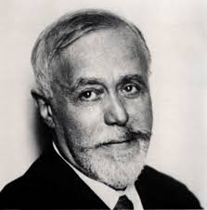
This piece was made world famous when it was used in the Disney Film Fantasia!
The Sorcerer's Apprentice was based on Goethe's 1797 poem "Der Zauberlehrling". Mickey Mouse, the young apprentice of the sorcerer Yen Sid, attempts some of his master's magic tricks but does not know how to control them.
https://youtu.be/2DX2yVucz24
Paul Abraham DukasThe Srceror’s Apprentice
1 October 1865 – 17 May 1935

Slide 13
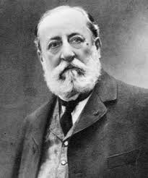
A French composer, pianist and organist. He was one of the greatest composers of his day. He composed lots of music of different kinds such as operas, orchestral works and became internationally famous.
https://youtu.be/z0glOYQBlSA
Camille Saint-Saëns
Danse Macabre
9 October 1835 – 16 December 1921

Slide 14
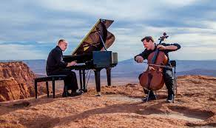
Piano guys perform ‘Angels We have heard on high’
The Piano Guys is an American musical group consisting of pianist Jon Schmidt, cellist Steven Sharp Nelson, videographer Paul Anderson, and music producer Al van der Beek. Originating in Utah, they gained popularity through YouTube, where in 2011 they began posting piano and cello compositions combining classical, pop, film score and original music, showcased through elaborate or cinematic videos.
https://youtu.be/n543eKIdbUI
The Piano guys

Slide 15
Spring term

Slide 16
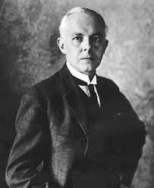
https://youtu.be/6tqOMxaGgBU
Béla Bartók composed his Romanian Folk Dances in 1915 for solo piano, and reworked it for orchestra two years later.
It is a set of six pieces based on folk tunes that would have originally been played on fiddle or fife. Each of the six movements is quite short, with the entire piece lasting only about 5 minutes.
Bartok; Romanian Folk Dances
(1881-1945)

Slide 17
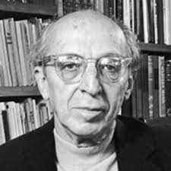
https://youtu.be/Xxd1cmenki8
Aaron Copland (1900-1990) was an American composer who wrote modern music.
He wrote music for the orchestra, piano, and voice. He wrote music for plays, movies, and dance. Copland also was a conductor, pianist, speaker, teacher, and writer.
Copland (1900-1990): Appalacha Spring

Slide 18
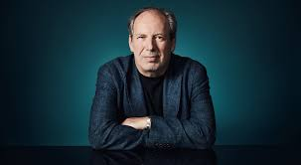
https://youtu.be/C0_sN4QwgSA
Hans Florian Zimmer (born 12 September 1957) is a German movie score composer and music producer. He has written music for over 100 movies.
His works include The Lion King (1994), Crimson Tide (1995), Gladiator (2000), Batman Begins (2005), The Dark Knight (2008), Inception (2010), Rango (2011), The Dark Knight Rises (2012), Man of Steel (2013), The Amazing Spider-Man 2 (2014), Batman v Superman: Dawn of Justice (2016), Dunkirk (2017), Widows (2018) and The Lion King (2019).
Hans Zimmer born 1957: Pirates of the Caribbean

Slide 19
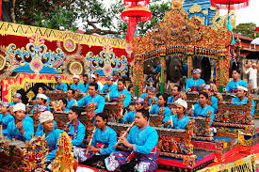
https://youtu.be/sZZTfu4jWcI
Gamelan is the traditional ensemble music of the Javanese, Sundanese, and Balinese peoples of Indonesia
It usually used as accompany Indonesian Traditional Puppets, Traditional Songs of Indonesia, and Traditional Dances of Indonesia.
Traditional music
Gamelon music: Indonesia

Slide 20
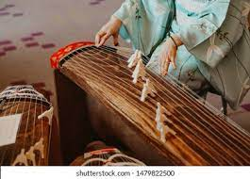
https://youtu.be/IITn9XHXT8k
Wagakki is a term used to refer to traditional musical instruments that have been used in Japan from ancient times.
Traditional Japanese music with musical instrument Wagakki

Slide 21
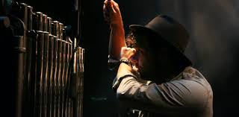
https://youtu.be/q7U1fvpuWWU
English composer and multi-instrumentalist Mike Oldfield began writing Tubular Bells 50 years ago, at the age of 17.
It was a hit in 1973
Tubular bells are a series of metal tubes of varying length, when tubular bells are struck they resemble the sound of church bells.
Tubular bells: Mike Oldfield
born 15 May 1953

Slide 22
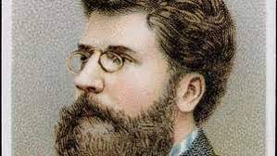
https://youtu.be/KjhDfcAdg7E
Bizet was a French composer of the romantic period.
He is best known for his opera “Carmen”, which is the best-known of all French operas.
The story of Carmen is set in Spain.
Georges Bizet
Carmen Overture: Orchestra
25 October 1838 – 3 June 1875

Slide 23
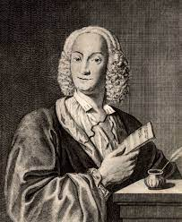
https://youtu.be/jDXBnS8mZ0E
Vivaldi was an Italian composer and a virtuoso violinist.
He was the most important composer in Italy at the end of the Baroque period.
Vivaldi wrote more than 400 concertos for various instruments, especially for the violin.
Vivaldi
The Four Seasons : Violin solo with String Orchestra
born Venice, 4 March 1678; died Vienna, 28 July 1741

Slide 24
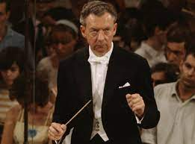
https://youtu.be/Ku3TRcjLpyY
Britten was probably the greatest English composer of his time.
He came from East Anglia (a region in the East of England) and he often thought about the East Anglian landscape and the sea when writing his Music.
Benjamin Britten
Young Persons Guide to the Orchestra
Born Lowestoft, 22 November 1913; died Aldeburgh, 4 December 1976

Slide 25
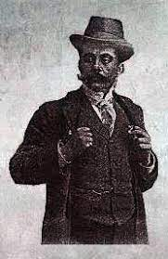
https://youtu.be/fYOsNp4O7AU
Vittorio was an Italian composer.
He was born in Naples where he studied violin and composition at the Conservatorio di San Pietro a Majella. Around 1900 he became the leader of the famous Lamoureux Orchestra in Paris, for which he wrote several ballets and operettas
Vittorio Monti’s
Czardas tuba Solo with string orchestra
6 January 1868 - June 20, 1922

Slide 26
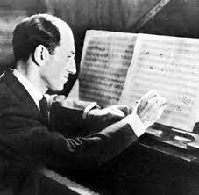
https://youtu.be/s5RnxMyjhfA
Gershwin, his two brothers and sister had a close, happy family life. George liked playing games on the streets of New York.
While exploring the city, Gershwin heard jazz and blues music spilling out of public drinking places. However, he did not become seriously interested in music until he heard another boy playing the violin in a concert at his school.
Gershwin began to take piano lessons.
Gershwin had his first big hit in 1919, when he was twenty-one years old. It was a song called "Swanee."
Gershwin
Rhapsody in Blue: Clarinet solo
September 26, 1898- July 11, 1937

Slide 27
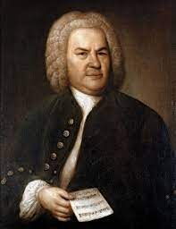
https://youtu.be/7FP-RW8-584
J S Bach was a composer and musician of the Baroque period, born in the Duchy of Saxe-Eisenach.
He is known for instrumental compositions such as the Brandenburg Concertos and the Goldberg Variations as well as for vocal music such as the St Matthew Passion. Since the 19th-century Bach Revival he has been generally regarded as one of the greatest composers of all time.
J.S.Bach
Air on a g string: Trombone solo
1685 – 28 July 1750

Slide 28
Summer term

Slide 29
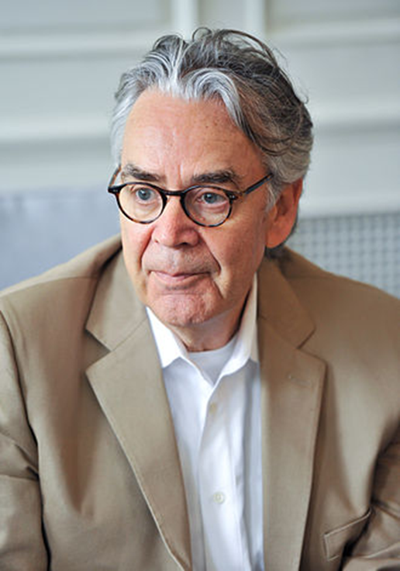
https://youtu.be/30b7_S0paCQ
The music of The Lord of the Rings film series was composed, orchestrated,
conducted and produced by Howard Shore.
Howard Leslie Shore OC (born October 18, 1946) is a Canadian composer and conductor
noted for his film scores.[1] He has composed the scores for over 80 films, most notably
the scores for The Lord of the Rings and The Hobbit film trilogies. He won three
Academy Awards for his work on The Lord of the Rings
https://youtu.be/meK0G3o9mPw
Lord of the Rings: The Shire

Slide 30
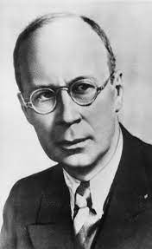
https://youtu.be/AT1zTPwd2Vk
Romeo and Juliet is a ballet. The music was written by Sergei Prokofiev.
The ballet is based on Shakespeare's play, Romeo and Juliet.
The ballet was first performed in Brno (now in the Czech Republic) in 1938.
Together with Dmitri Shostakovich he is one of the greatest Russian composers of the 20th century. Children all over the world love to listen to his musical story Peter and the Wolf and the music for Lieutenant Kije, but he wrote many other great works including symphonies, concertos, piano sonatas, ballets and operas.
Romo and Juliet by Prokofiev
Russian Composer
Ukraine 23 April 1891; died Moscow 5 March 1953

Slide 31
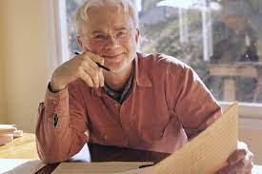
Short ride in a fast machine John Adams
https://youtu.be/5LoUm_r7It8
John Coolidge Adams is an American composer. He was born in 1947. His music often uses minimalism with large orchestras and lots of different sounds. He was named after John Adams, the 2nd President.
In music, minimalism is a way of composing classical music which became popular during the second half of the 20th century. It is a way of composing by using a simple idea which is repeated many times. A minimalist piece of music usually takes a short idea which may be a melodic or a rhythmic pattern. This idea is then repeated many times, but each time it changes slightly.
Short ride in a fast machine John Adams
1947

Slide 32
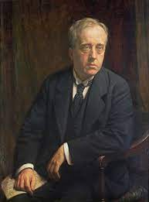
https://youtu.be/Gu77Vtja30c
Jupiter was the king of the gods. Holst decided, based on his astrological beliefs, that the planet was responsible for happiness and celebration. The music here is majestic and grand—perfect for the king of the gods.
The central melody of “Jupiter” has been used for hymns and other songs, including the theme song for the Rugby World Cup.
Jupiter from the Planets by Holst
Jupiter, the Bringer of Jollity
1874 – 25 May 1934

Slide 33
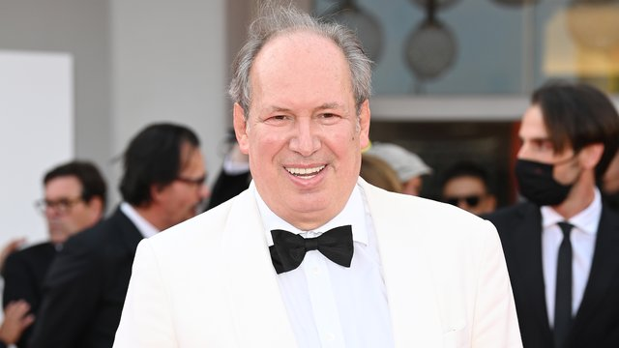
https://youtu.be/W30QNDapVDA
Planet Earth II is a 2016 British nature documentary series produced by the BBC as a sequel to Planet Earth, which was broadcast in 2006.
The series is presented and narrated by Sir David Attenborough with the main theme music composed by Hans Zimmer.
The German musician is one of the world's best-known film composers, having written the soundtracks for ‘The Lion King’, ‘The Dark Knight’ and ‘Gladiator’.
Hans Zimmer 1957- present
Planet Earth 2

Slide 34
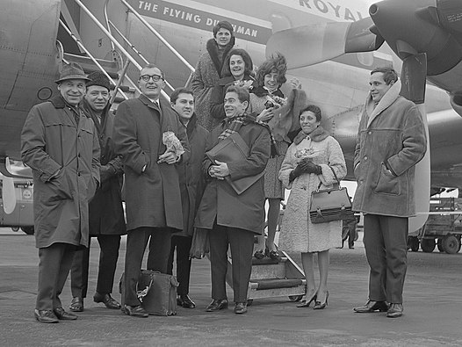
https://youtu.be/nK69zl19c0Y
o
The Swingles are a French vocal group formed in 1974 in England by Ward Swingle.
The group began as session singers mainly doing backing vocals for singers
The eight session singers sang through Bach's Well-Tempered Clavier as a sight-reading exercise and found the music to have a natural swing.
They recorded their first album Jazz Sébastien Bach as a present for friends and relatives.
Many radio stations picked it up and this led to the group recording more albums and winning a total of five Grammy Awards.
The French group performed and recorded typically with only a double bass and drums as accompaniment.
Swingle Singers
Singing Bach’s Fugue in Gminor

Slide 35
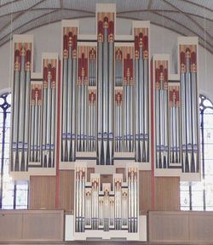
https://youtu.be/m_HdrywerGE
The pipe organ is a keyboard instrument in which the sound is made by air blowing through pipes. A person who plays the organ is called an organist. The organist plays the instrument using both the hands and the feet. The hands play the keyboards (called manuals), while the feet play pedals which also make notes.
Go tell it on the mountain: an African-American spiritual song
Organ Solo

Slide 36
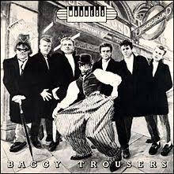
https://youtu.be/Dc3AovUZgvo
"Baggy Trousers" is a song by English ska/pop band Madness from their 1980 album Absolutely. It was written by lead singer Graham "Suggs" McPherson and guitarist Chris Foreman, and reminisces about school days.
The band first began performing the song at live shows in April 1980.
It was released as a single on 5 September 1980 and spent 20 weeks in UK charts, reaching a high of 3.
Madness: English Ska and pop band from North London
Baggy Trousers

Slide 37

https://youtu.be/bx1Bh8ZvH84
Wonderwall is a single by the rock band Oasis from Manchester. It was written by Noel Gallagher about a girl he met at a concert when he was touring with Oasis.
Wonderwall was the only song that reached the top 10 in America on the Hot 100 for Oasis. It also reached number 1 in four countries and reached the top 10 in 10 countries.
Oasis; Rock band from Manchester
Wonderwall

Slide 38
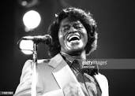
https://youtu.be/W-rn7i_ETYc
James Brown was born on May 3rd, 1933 in South Carolina, United States of America.
James Brown was one of the founders of funk music which was developed during the 1960s and derived from a mixture of soul, R&B and jazz music, and had a blend of rhythm and dance mixed in. This new type of music was founded by African-American musicians and consisted of rhythm instruments such as the drums, electric bass and guitar, and the organ.
James Brown's success in the music business and development of soul music earned him the nickname 'The Godfather of Soul’.
He was musically gifted in many ways.
He could play several instruments including the percussion, organ and drums.
James Brown produced 92 Hot 100 Hits between 1958 and 1986.
James Brown : American singer and composer
May 3, 1933 – December 25, 2006
I got you

Slide 39
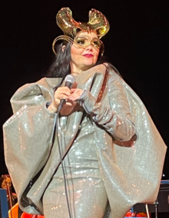
https://youtu.be/htobTBlCvUU
Bjork is an Icelandic singer, songwriter, composer, record producer, and actress. Noted for her distinct three-octave vocal range and eccentric persona, she has developed an eclectic musical style over her four-decade career that has drawn on electronic, pop, experimental, trip hop, classical, and avant-garde music.
Björk began her music career at the age of 11 and gained international recognition as the lead singer of the alternative rock band the Sugarcubes by the age of 21
Bjork
born 21 November 1965
It’s oh so quiet

Slide 40

https://youtu.be/SacuV0kEQlA
“Jai Ho! (You Are My Destiny)" is a song by Indian composer A. R. Rahman and American girl group the Pussycat Dolls for the 2008 film Slumdog Millionaire.
The song won an Academy Award for Best Original Song and a Grammy Award for Best Song Written for a Motion Picture, Television or Other Visual Media.
Rahman is an Indian music composer, record producer, singer and songwriter, popular for his works in Indian cinema; predominantly in Tamil and Hindi films, with occasional forays in international cinema.
He is a winner of six National Film Awards, two Academy Awards, two Grammy Awards, a BAFTA Award, a Golden Globe Award, fifteen Filmfare Awards and seventeen Filmfare Awards South.
In 2010, the Indian government conferred him with the Padma Bhushan, the nation's third-highest civilian award.
A R Rahman: An Indian composer, record producer, singer, songwrite, musician.
6 January 1967
Jai ho

