Slide 1
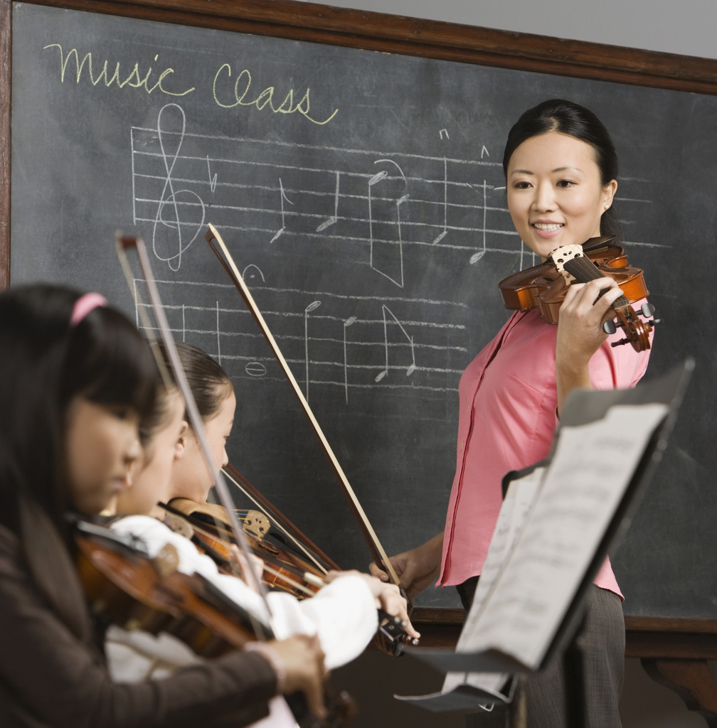
Assembly Music years 1 and 2

Slide 2
Autumn term

Slide 3
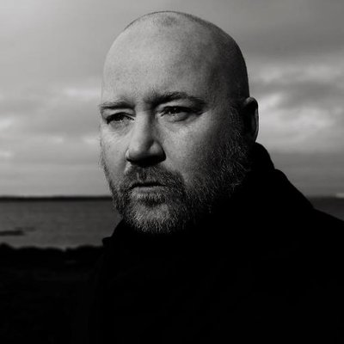
A famous modern composer from Iceland who scored the music to TV and Films
Arrival of the birds: Mystery of the flamingos: https://youtu.be/tafqaf3myjk
By film composer Johann Johannsson
Johann Johannson
1969-2018

Slide 4
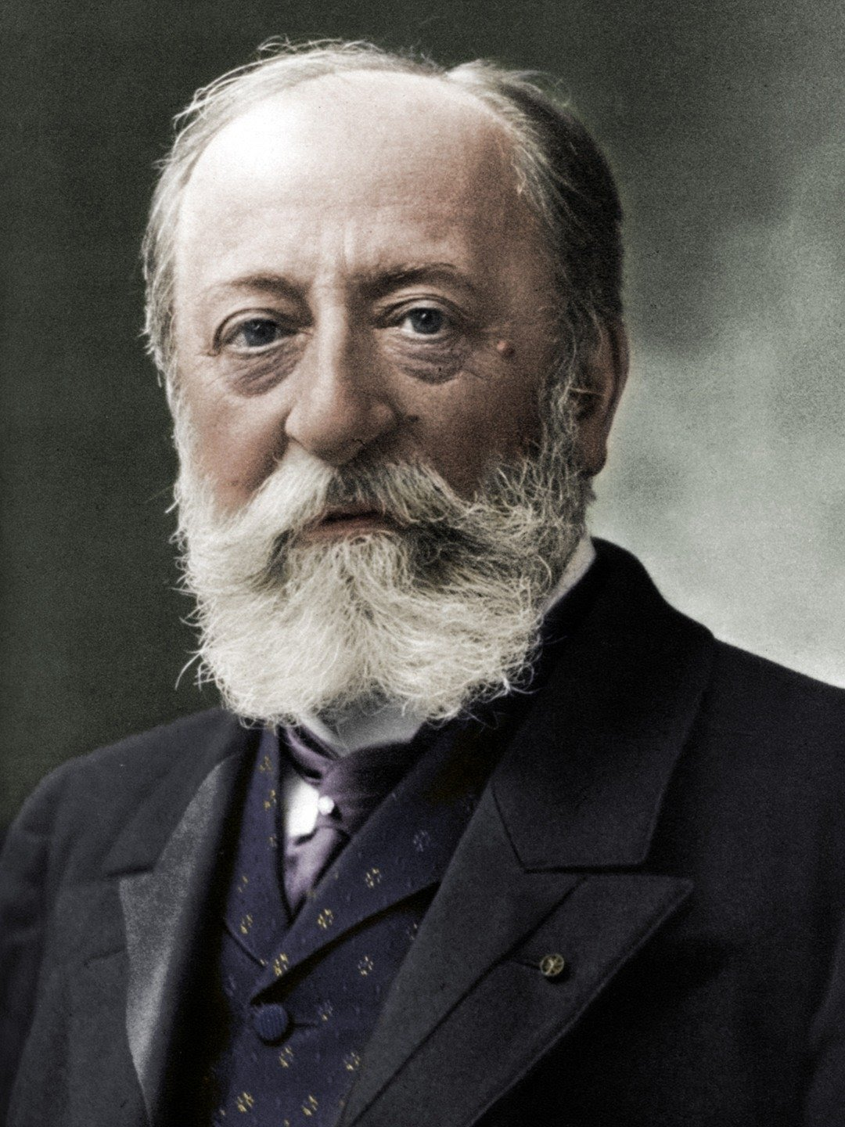
Aquarium by Saint-Saens from Carnival of the Animals
https://youtu.be/IyFpZ5MZ7kk
Saint-Saëns was born in 1835 in France. His father passed away only three months after his birth and he was raised by his mother and his great-aunt Charlotte who introduced him to the piano at the age of two. By the time he was four, he had already written his first composition in 1839

Slide 5
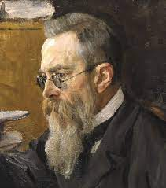
Flight of the Bumble Bee by Rimsky Korsakov
https://youtu.be/P5UL1kh9qcM
Nikolai Andreyevich Rimsky-Korsakov, was a Russian composer. He was one of the most famous composers of his time and influenced a lot of other composers. Like so many Russian composers in the 19th century, he was an amateur composer. His main job was in the navy.
"Flight of the Bumble Bee" is a musical composition by Nikolai Rimsky-Korsakov for solo violin and orchestra. It was written as an interlude for his opera, The Tale of Tsar Saltan (1899-1900). The music depicts the buzzing of a bumble bee in its flight.

Slide 6
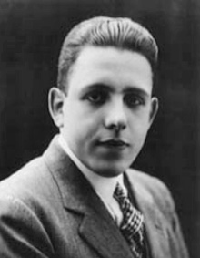
The story of Babar, the Little Elephant https://youtu.be/VwK5wPXJ7e0
Poulenc – (7 January 1899 – 30 January 1963) was a French composer and pianist. His compositions include songs, solo piano works, chamber music, choral pieces, operas, ballets, and orchestral concert music.
In addition to his work as a composer, Poulenc was an accomplished pianist.

Slide 7
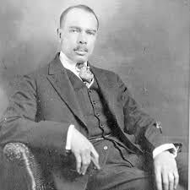
Johnson was a leader of the National Association for the Advancement of Colored People and he and his wife campaigned for civil rights for black people.
https://youtu.be/ngFDy52eCZY
James Weldon Johnson
Lift every Voice
(June 17, 1871 – June 26, 1938)

Slide 8

Celebrate Black People Who Change the World
This video was filmed and edited by Miss Jessica.
This music was performed and produced by Miss Jessica
Grammy Nominated Song: A celebration of black excellence in American history both past and present. ​
https://youtu.be/ROd8bemv0bI

Slide 9
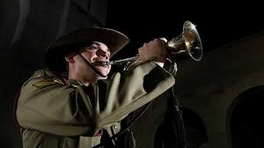
The "First Post" call signals the start of the duty officer's inspection of a British Army camp's sentry posts, sounding a call at each one.
The "Last Post" call originally signalled merely that the final sentry post had been inspected, and the camp was secure for the night.
In addition, the "Last Post" call had another function at the close of a day of battle.
It signalled to those who were still out and wounded or separated that the fighting was done, and to follow the sound of the call to find safety and rest.
The Last Post
https://youtu.be/99tCg596QSc

Slide 10
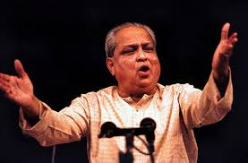
Kumar was an Indian classical singer, well known for his unique vocal style and his refusal to be bound by the tradition of any gharana
https://youtu.be/qjGVLvpWSOs
Kumar Gandharva
Deepki Jyot Jale
8 April 1924 – 12 January 1992

Slide 11
Jurassic World Evolution - All 48 Dinosaurs https://youtu.be/czTQyUKAWKM
Some Facts about dinosaurs:
1. The word dinosaur comes from the Greek language.
Coined by English paleontologist Richard Owen in 1842, the word dinosaur means “terrible lizard,” but it’s not because they are scary—it refers to their enormous size!
2. Dinosaurs ruled the Earth for more than 150 million years.
The lizard-like reptiles were the predominant animals on this planet, and some of them remain the largest, most terrifying creatures to ever exist! Beginning about 230 million years ago, dinosaurs roamed the planet from the Triassic period through the Jurassic period until the end of the Cretaceous period around 65 million years ago.
3. Dinosaurs became extinct about 65.5 million years ago.
No one is exactly sure why the dinosaurs died out. Some believe the climate became too hot or cold for them to exist. Others say that a huge asteroid collided with Earth—if this was true, why did some species, including the ancestors of frogs, turtles, and even birds, survive? It’s a mystery!

Slide 12
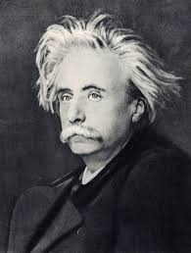
Grieg was a Norwegian composer and pianist.
He is widely considered one of the leading Romantic era composers
His use and development of Norwegian folk music in his own compositions brought the music of Norway to fame, as well as helping to develop a national identity.
https://youtu.be/r__Dk4oWGJQ
Edvard Hagerup Grieg
In the hall of the mountain king
15 June 1843 – 4 September 1907

Slide 13
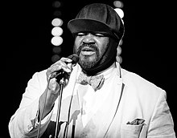
Gregory Porter is an American singer, songwriter and actor.
He has twice won the Grammy Award for Best Jazz Vocal Album: first in 2014 for Liquid Spirit and then again in 2017 for Take Me to the Alley.
https://youtu.be/CkQ3BxaAmw0
Gregory Porter
The Christmas Song
(born November 4, 1971)

Slide 14
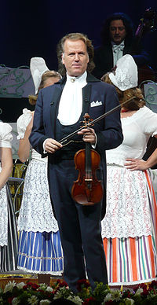
Andre Rieu
is a Dutch violinist and conductor best known for creating the waltz-playing Johann Strauss Orchestra.
https://youtu.be/8VfYKmJkxl0
André Rieu
Oh Holy night
(born 1 October 1949)

Slide 15
Spring term

Slide 16
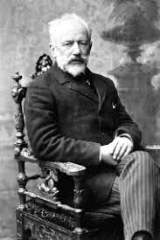
https://youtu.be/UYaIQNjAX_8
The Nutcracker was performed exclusively in Russia, and then throughout Europe
The Waltz of the Flowers is the final dance of the ballet where all the Sugar Plum Fairy's sweets celebrate Clara and the prince.
The nutcracker ballet : Waltz of the Snowflakes by Tchaikovsky (1892)

Slide 17
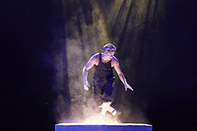
https://youtu.be/w0v_pu6miJ8
Riverdance is a theatrical show consisting mainly of traditional Irish music and dance
With a score composed by Bill Whelan, it originated as an interval performance act during the 1994 Eurovision Song Contest, featuring Irish dancing champions Jean Butler, Michael Flatley
Riverdance at the Eurovision Song Contest

Slide 18
The Ocean: Scenic wildlife film with calming music
https://youtu.be/eoTpdTU8nTA
The Ocean is one of the most incredible places on earth.
Enjoy this 4K Scenic Wildlife Film featuring the diverse animals and scenery of the ocean.
From vibrant coral reefs, to majestic dolphins, the Ocean is a fascinating place.
What is your favorite animal in the Ocean?

Slide 19
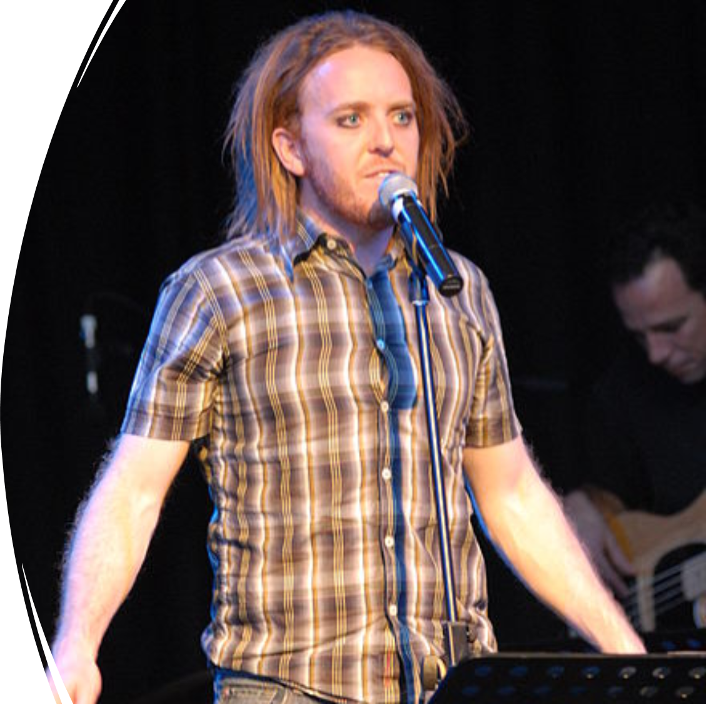
https://youtu.be/e0tRDhEmdO4
Tim Minchen is an Australian comedian, actor, writer, musician, and songwriter who refers to himself as a call comedic minstrel.
He was born in Northampton, England, to Australian parents,[ and raised in Perth, Western Australia.
https://youtu.be/2LMn5MS8_Ag
Matilda: When I grow Up
Tim Minchen
Born 7 October 1975.

Slide 20
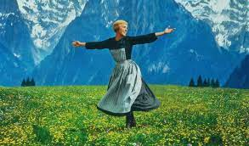
https://youtu.be/3ToL7p6HL3Q
The Sound of Music is a musical.
It was based on a 1956 German movie, Die Trapp-Familie and The Story of the Trapp Family Singers by Maria von Trapp.
A young Austrian woman named Maria Rainer becomes the governess to the children of Captain Georg von Trapp, a widow.
Maria teaches the children how to sing, during the famous song Do Re Mi. The captain and Maria fall in love and marry. Von Trapp refuses to join the Nazis and escapes from the Salzburg Festival, where his family performed. The story ends with Maria and her family leaving from Austria to Switzerland.
Sound of music
The book was written by Howard Lindsay and Russel Crouse. The lyrics were written by Oscar Hammerstein II. The music was written by Richard Rodgers.

Slide 21
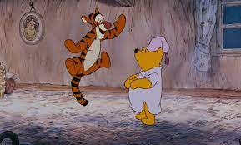
https://youtu.be/HnVnS6dtpXs
"The Wonderful Thing About Tiggers" is the theme song and personal anthem of Tigger, originally featured in Winnie the Pooh and the Blustery Day. It is repeated in Winnie the Pooh and Tigger Too! and again in the 1977 release The Many Adventures of Winnie the Pooh. It opens up the 2000 release of The Tigger Movie. It is also heard briefly in Piglet's Big Movie, Winnie the Pooh and in Christopher Robin. In 1974, Paul Winchell earned a Grammy award for his rendition of the song.
Winnie the Pooh- The Wonderful thing about Tiggers
The music, lyrics and the idea were composed and written by Richard M. Sherman and Robert B. Sherman.

Slide 22
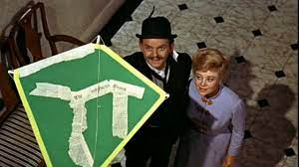
https://youtu.be/56GRSGxe5nI
"Let's Go Fly a Kite" is the final song in the film Mary Poppins. It is played during the end of the film. During it, the Banks family goes out to spend time with the newly reformed George and the neighbors.
The song is featured in Saving Mr. Banks, in a scene where the Sherman Brothers sing it for P.L. Travers to show her they made revisions on George's character. At that point, she begins to warm up to them and joins in with their singing. (Contrary to the film's portrayal, she did not approve of any of the songs other than "Feed the Birds (Tuppence a Bag)" and "Stay Awake".)
Mary Poppins: Let’s go Fly A Kite

Slide 23
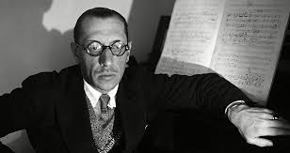
Stravinsky was most famous for his ballet compositions, Petrushka, The Firebird and The Rites of Spring.
Walt Disney made a version using the music with dinosaurs in animation
https://youtu.be/An4SNq-DvU0
Igor Stravinsky
Infernal Dance
17 June 1882 – 6 April 1971

Slide 24
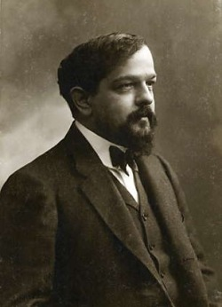
Clair De Lune (moonlight) by Debussy
Claude Debussy (1862-1918) was a French composer. He started studying music when he was nine. From age ten on he studied in the Paris Conservatory time. He won the Prix de Rome while at the Paris Conservatory.
Debussy's musical style is often titled as "impressionism."
https://youtu.be/k8JwihcysWo
Claude Debussy (1862-1918)

Slide 25
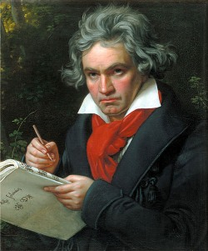
Moonlight Sonata with elephants.
Ludwig van Beethoven was a German composer and pianist.
He is one of the most famous composers of all time.
His musical style was in between the classical period and the romantic.
Beethoven was a virtuoso (really good) pianist.
He composed a lot of piano music, and of course he performed his own music.
His 32 piano sonatas are specially famous. You may have heard about the Moonlight sonata, the Appassionata, or the Pathétique.
https://youtu.be/_4AcjvsVn5k
Ludwig Van Beethoven: (1770-1827)

Slide 26
https://youtu.be/-WsqK1mCGeY

Slide 27
Stravinsky was most famous for his ballet compositions, Petrushka, The Firebird and The Rites of Spring.
https://youtu.be/-WsqK1mCGeY
Igor Stravinsky: Finale of the firebird
17 June 1882 – 6 April 1971

Slide 28
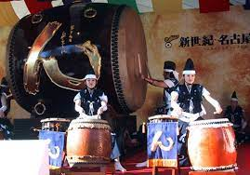
https://youtu.be/C7HL5wYqAbU
Taiko Drumming is a blend of music and various martial arts that either originated in Japan or have been imported from China.
The taiko is a large, drum-like instrument of the percussion family that is believed to have originated in Korean and Chinese culture and was introduced to Japan in the 6th century CE. Throughout their history taiko have been used for a variety of purposes including military, theatrical, religious, festival, concert, and communication.
Japanese Drummers Taiko

Slide 29
Summer term

Slide 30
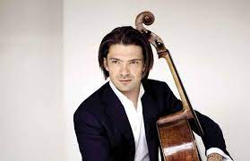
https://youtu.be/IpWoSDsUJu8
Gautier Capuçon was born in Chambery, Savoie
He is the youngest of three siblings.
He started learning the cello when he was four years old
He is also an accomplished pianist. He started learning the piano at the age of seven
Gautier Capucon
The Swan: Cello Solo
born 3 September 1981

Slide 31
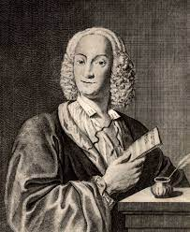
https://youtu.be/jDXBnS8mZ0E
Vivaldi was an Italian composer anda virtuoso violinist.
He was the most important composer in Italy at the end of the Baroque period.
Vivaldi wrote more than 400 concertos for various instruments, especially for the violin.
Vivaldi
The Four Seasons : Violin solo with String Orchestra
born Venice, 4 March 1678; died Vienna, 28 July 1741

Slide 32
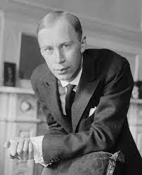
Prokofiev was a Russian composer and pianist who came from Ukraine.
During his lifetime, Ukraine was part of Russia. Together with Dmitri Shostakovich he is one of the greatest Russian composers of the 20th century.
Children all over the world love to listen to his musical story Peter and the Wolf and the music for Lieutenant Kije, but he wrote many other great works including symphonies, concertos, piano sonatas, ballets and operas.
Prokofiev
Peter and the Wolf Narration and music
23 April 1891; died - 5 March 1953

Slide 33
https://youtu.be/MfM7Y9Pcdzw
Prokofiev was a Russian composer and pianist who came from Ukraine.
During his lifetime, Ukraine was part of Russia. Together with Dmitri Shostakovich he is one of the greatest Russian composers of the 20th century.
Children all over the world love to listen to his musical story Peter and the Wolf and the music for Lieutenant Kije, but he wrote many other great works including symphonies, concertos, piano sonatas, ballets and operas.
Prokofiev
Peter and the Wolf Narration and music
23 April 1891; died - 5 March 1953

Slide 34
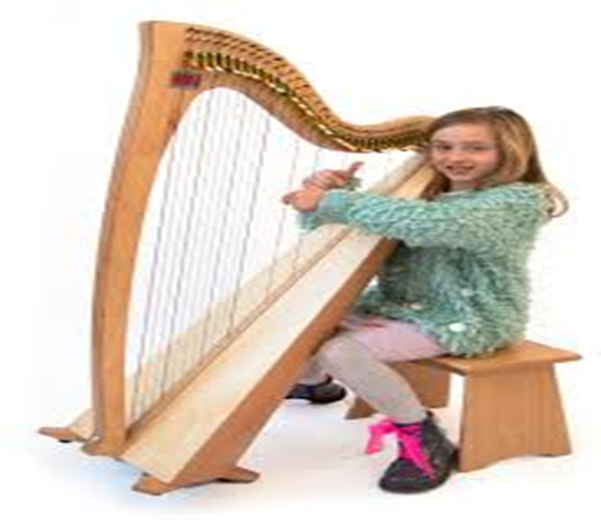
https://youtu.be/qvyijUMqp_U
The harp is a musical instrument. It is the second biggest string instrument in an orchestra. It dates back to 4000 BC when the Egyptians used them in holy places. Christian artists often draw angels playing harps in Heaven
A trip to the islands
Irish Harp Solo

Slide 35
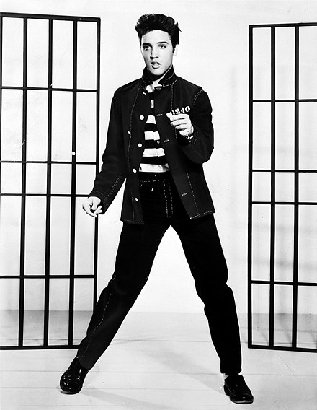
https://youtu.be/T1Ond-OwgU8
Elvis Aaron Presley was an American singer and actor. Dubbed the "King of Rock and Roll", he is regarded as one of the most significant cultural icons of the 20th century.
"Blue Suede Shoes" is a rock-and-roll standard written and first recorded by Carl Perkins in 1955. It is considered one of the first rockabilly records, incorporating elements of blues, country and pop music of the time.
Elvis Presley
Blue Suede Shoes
January 8, 1935 – August 16, 1977

Slide 36
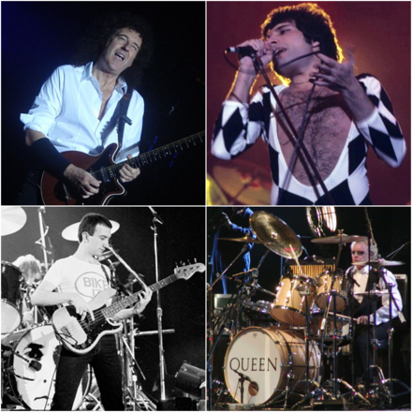
https://youtu.be/-tJYN-eG1zk
Queen are a British rock band formed in London in 1970. Their classic line-up was Freddie Mercury (lead vocals, piano),
Brian May (guitar, vocals),
Roger Taylor (drums, vocals)
and John Deacon (bass).
Queen
We will rock you

Slide 37
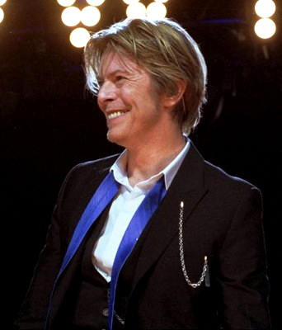
https://youtu.be/iYYRH4apXDo
David Robert Jones known as David Bowie, was an English singer-songwriter and actor. A leading figure in the music industry, Bowie is regarded as one of the most influential musicians of the 20th century.
He grew up in Bromley, Kent. He played the saxophone.
David Bowie
This is Major Tom

Slide 38
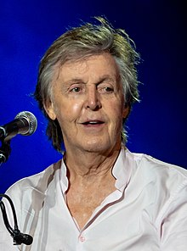
https://youtu.be/PcDVH8DiBnM
"We All Stand Together" is from the animated film Rupert and the Frog Song and reached number three in the UK Singles Chart in 1984.
Rupert Bear decides to head off for a walk on the hills. With his Mother's blessing, he sets off for a jolly trip, encountering his friends Edward Elephant and Bill Badger along the way, who are too busy to join him - Bill needs to look after his baby brother and Edward has to do some shopping. As Rupert reaches a hill, he props himself up against the trunk of an oak tree and enjoys the glory of the countryside. Suddenly, he finds himself enveloped by a rainbow cloud of butterflies previously masquerading as leaves on the oak tree, and all of them swarm away from the leafless tree towards a rocky outcrop; Rupert cannot resist following them. As he leaves, a large white barn owl and two black cats decide to follow him.
Upon the rocks, Rupert finds a large number of multicolored frogs. He walks into a cave behind a waterfall and sees three signs: "Frogs only beyond this point", "Everything except frogs must be kept on a lead", and "Guard frogs operating". He sneaks into the palace, trying to avoid getting caught by the frog guards. There, he witnesses the Frog Song, an event that occurs only once in a few hundred years in which various frogs of all shapes and sizes come together and sing "We All Stand Together". Around the end, the frog King and Queen rise out of the water before the crowd to finish off the song. After a thunderous applause from the frogs, the owl, who had followed Rupert to find out where the frogs were hiding, launches itself for an attack on the royals, but Rupert manages to warn the frogs in time and they all quickly retreat, leaving the owl and the cats empty-handed and the palace completely empty. After hearing his mother call him, Rupert excitedly rushes home to tell his family about what he saw.
Paul Mcartney
frog Song

Slide 39
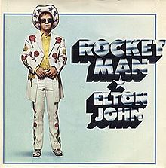
https://youtu.be/-arJlV12Icc
Space exploration was big in 1972; the song came out around the time of the Apollo 16 mission, which sent men to the moon for the fifth time.
The inspiration for Bernie Taupin's lyrics, however, was the short story The Rocket Man, written by Ray Bradbury. The sci-fi author's tale is told from the perspective of a child, whose astronaut father has mixed feelings at leaving his family in order to do his job.
Elton John
Rocket Man 1972 i

Slide 40
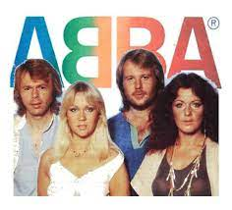
https://youtu.be/4069PUk3aM0
ABBA became very popular after they won the Eurovision Song Contest in 1974. They had many hits. These included "Dancing Queen", "SOS", "Mamma Mia", and "Waterloo". Most of their songs were written by Ulvaeus and Andersson.
They originally broke up in 1982 but their music was still popular. Their music also appeared in movies (including the Australian movies The Adventures of Priscilla, Queen of the Desert and Muriel's Wedding) and the musical Mamma Mia!.
The group was inducted into the Rock and Roll Hall of Fame in 2010. In 2015, their song "Dancing Queen" was inducted into the Recording Academy's Grammy Hall of Fame.
In 2018 it was announced that the band had reunited and recorded two new songs after 35 years of being inactive. Voyage, their first studio album in 40 years, will be released in November 2021.
Abba
Thankyou for the music

Slide 41
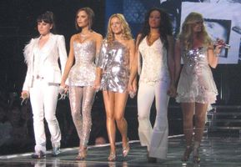
https://youtu.be/BDX8eTORFCo
The Spice Girls are a British pop girl group. The group formed in 1994.
The group has five members.
Each member uses a nickname initially given to them: Melanie Chisholm ("Sporty Spice"), Emma Bunton ("Baby Spice"), Melanie Brown ("Scary Spice"), Victoria Beckham (née Adams) ("Posh Spice"), and Geri Halliwell ("Ginger Spice") .
They were signed to Virgin Records. The Spice Girls released their debut single, "Wannabe" in 1996. It hit number-one in more than 30 countries. The song helped make the group as a global phenomenon. The group is credited for being starting the trend of commercial success of teen pop in the late 1990s.
Spice Girls
Wannabe

Slide 42
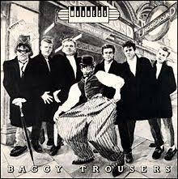
https://youtu.be/Dc3AovUZgvo
"Baggy Trousers" is a song by English ska/pop band Madness from their 1980 album Absolutely. It was written by lead singer Graham "Suggs" McPherson and guitarist Chris Foreman, and reminisces about school days.
The band first began performing the song at live shows in April 1980.
It was released as a single on 5 September 1980 and spent 20 weeks in UK charts, reaching a high of #3
Maddness
Baggy Trousers

